Slide 1





























Git for DBAs
A Simple Intro
Notes:
Every IT professional should learn the basics of Git. Even if you rarely work closely with developers, Git is such a powerful way to store and share operational scripts and configuration files that Git literacy is essential.
In this session, we will cover the following, using free tools:
* The basics of different Git implementations
* How to create a Git repo in Azure DevOps
* Essential Git commands for managing and sharing changes
* Tips for learning the Git CLI and using Git in Azure Data Studio
* How to use Git with Flyway, an open source database deployment tool

Slide 2

Kendra Little
littlekendra@gmail.com
@Kendra_Little

Slide 3
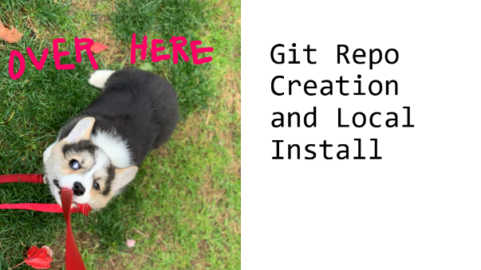
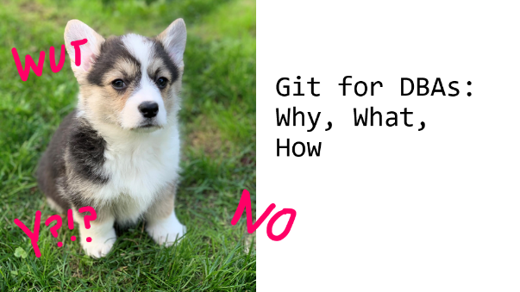


Topics

Slide 4








Git for DBAs: Why, What, How

Slide 5











Why Git?
File shares are unreliable
Broadly accepted
Version, share, improve
Config files
Scripts
Database code
Applications
Basis for automation

Slide 6


























Git is a distributed VCS

Slide 7


















Git hosting options
Github
Bitbucket
Gitlab
Azure DevOps repos
Github Gists

Slide 8












Using Git for database code
Multiple tools, some fancy
Auto-generate SQL
CI/CD components
Multi-database support
Today I’m showing a simple deployment tool, Flyway

Slide 9








Git Repo Creation and Local Install

Slide 10





Demo: Create and clone your repo

Slide 11











Essential Git Commands

Slide 12









Merge is your friend
Assumption: Branching and merging sounds hard, we’ll learn it later
Reality: Git is easier to use when you embrace branching

Slide 13































Kathi pushes commits to main
I have local commits to main

Slide 14
Kathi pushes commits to boop, does Pull Request to merge to main
I’ve committed in schmoo
I pull main and merge main into schmoo
I push schmoo and do a Pull Request to merge to main

Slide 15











What should I use?
Git CLI – Command Line Interface
VSCode and Azure Data Studio (ADS) – Simple, free GUI

Slide 16




Demo: Using Git

Slide 17



References & Discussion

Slide 18

















Comments? Questions?
Git repo: https://github.com/LitKnd/GitForDBAs
Cheat sheet: https://littlekendra.com/2019/11/27/my-git-cli-cheat-sheet/
Rob Sewell: https://sqldbawithabeard.com/2019/11/29/how-to-fork-a-github-repository-and-contribute-to-an-open-source-project/

